Slide 1
Improved Analytical Separation of Long Oligonucleotides Using a Novel 1000Å Column
Joshua McBee, Ph.D, Barry Boyes, Ph.D., Peter Pellegrinelli, M.S.

Slide 2
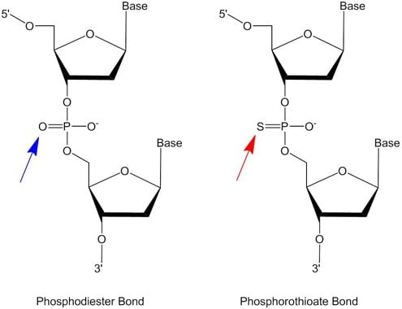
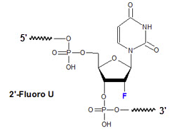
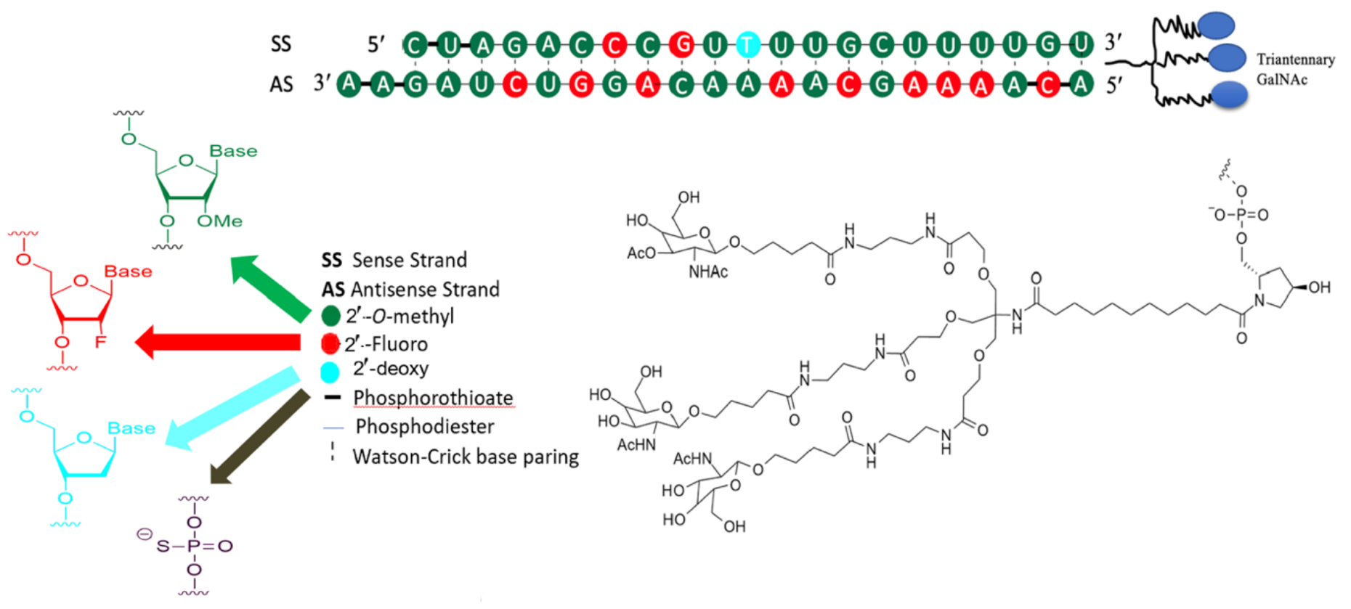
Growing Complexity of Oligos
Oligonucleotide Structural Forms
Oligonucleotides exist as single strands or duplexes with secondary structures affecting separation.
Chemical Modifications
Phosphorothioate and 2’-O-methyl modifications alter oligonucleotide stability and chromatographic properties.
Chromatographic Challenges
Modifications create positional isomers and affect retention, requiring tailored chromatography strategies.
Conjugates in Oligonucleotides
Incorporating lipids or peptides enhances delivery but adds complexity to chromatographic analysis.
Inclisiran (LEQVIO)
Ebenezer et al. Int J Mol Sci 2023 24(4), pp4019
Notes:
Oligos are very hydrophilic.
This makes their separation with significant resolving power challenging
Options: ion exchange – limited resolving power, LCMS incompatible
HILIC – Not widely used, typically not very durable at physio pH
IP/RP – strong ion pairs, LCMS compatible

Slide 3
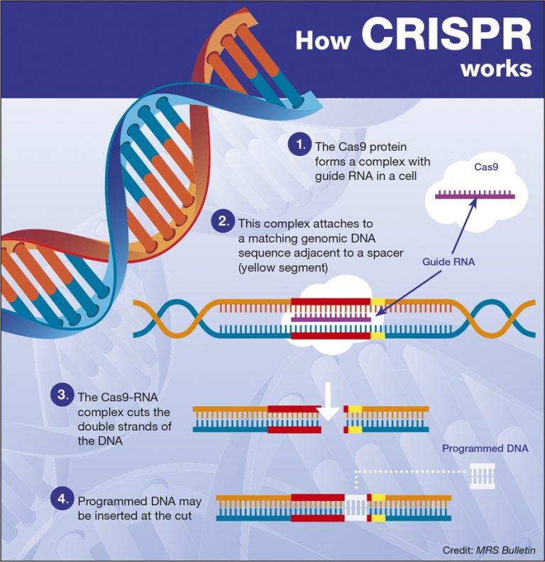
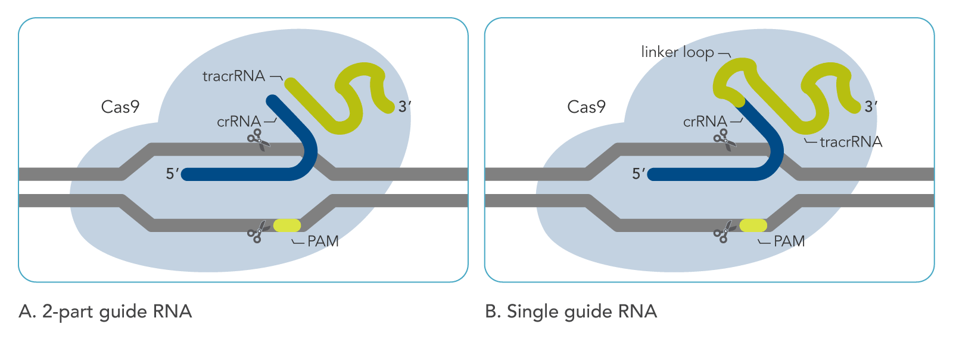
Therapeutic Oligos are Getting Longer!
Small RNAs (<50bp)
ASOs
siRNAs
Medium RNAs (50bp-150bp)
sgRNA (90-110bp; 30 kda)
Phosphorothioated
2’ modifications
Low yields by SPSS
Large RNAs (>500bp)
mRNA
In vitro transcription
In vitro modifications
Notes:
The longer the oligo synthesized and with the more modifications, the lower the yield and the greater requirement to separate FLP from impurities and have resolving power to characterize existing impurities.

Slide 4
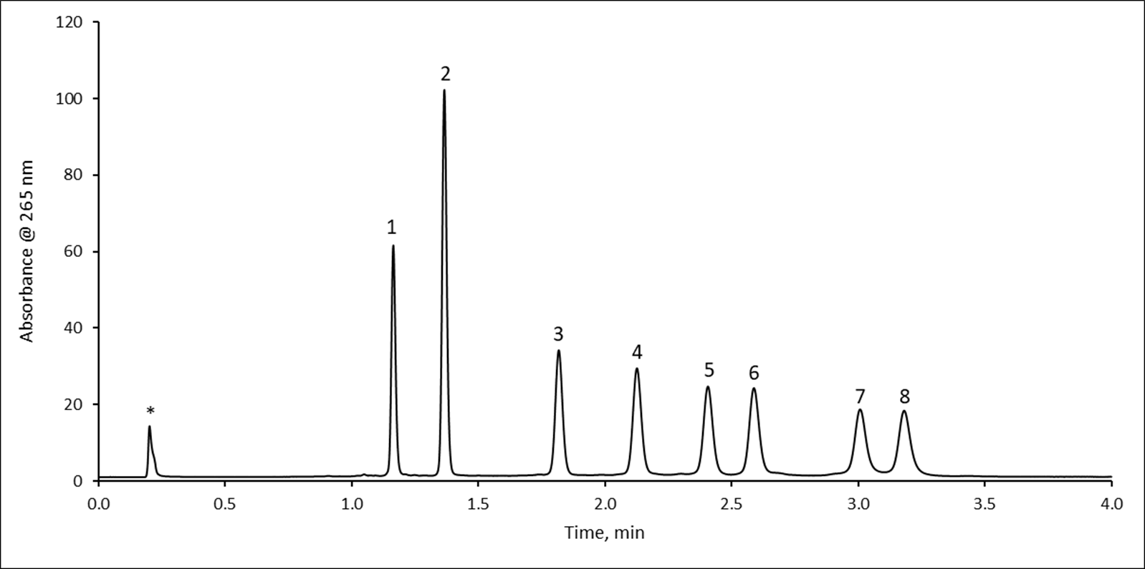
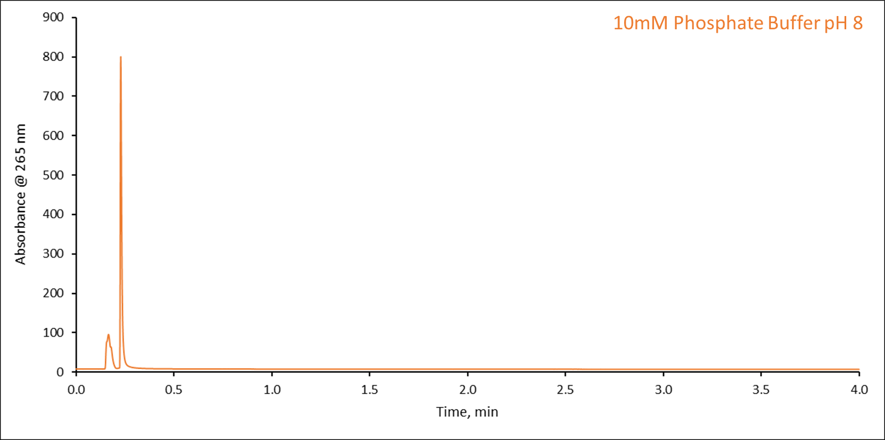

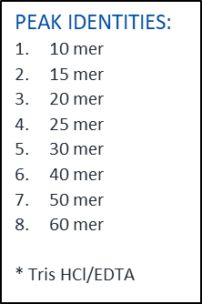
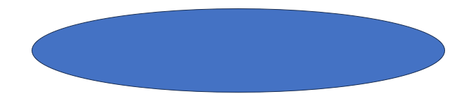
Ion Pair /Reversed Phase HPLC
Contemporary oligonucleotide analysis is frequently conducted using ion pair reversed phase chromatography (IPRP).
TEA (triethylamine) or TEA-Acetate (TEAA) buffer is a common IPRP modifier, creating favorable IPRP separations.
Phosphate buffer does not support IPRP, meaning little to no retention.
Dynamic Ion-exchange model
Ion Pair agent acts as a bridge
Oligo
Ion Pair
+
-
-
+
+
C18
+
-
+
+
-
Sorbent
Adapted from Gilar and Stoll LCGC International Jan 2, 2026
Notes:
Oligos are highly polar and by themselves are poorly retained on C18, therefore you need a bridge
Ion pair vs non ion pair

Slide 5
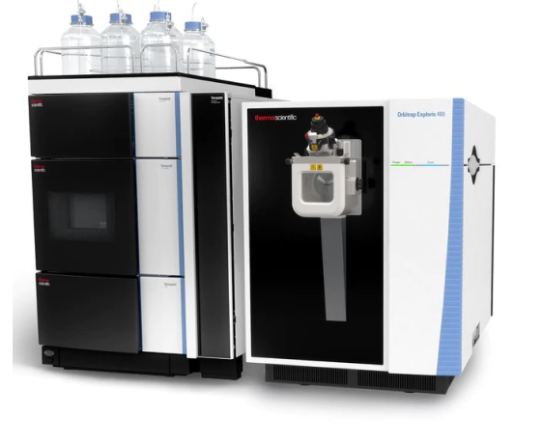
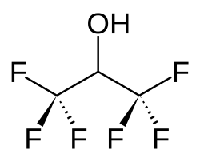
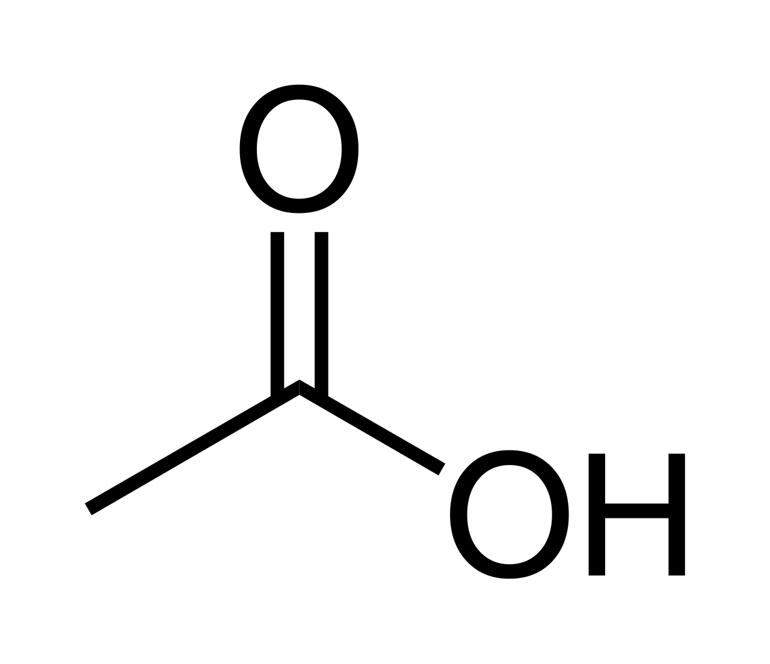
Why LC-MS is Essential for Oligonucleotide Analysis
Separation and Structural Characterization​
LC-MS provides both chromatographic separation and detailed structural analysis of oligonucleotides for accurate identification.​
High Specificity and Sensitivity​
Mass spectrometry distinguishes closely related oligonucleotide species, enabling precise impurity quantification and regulatory compliance.​
Stability and Modification Monitoring​
LC-MS supports stability studies and detects chemical modifications and where they reside, including phosphorothioate linkages and conjugates.​
Gold Standard for Quality Control​
Combining chromatography with mass detection, LC-MS ensures comprehensive quality control in pharmaceutical oligonucleotide analysis.
Why HFIP + Amine Systems?
HFIP (Hexafluoro‑isopropanol)Weak, volatile fluoroalcohol commonly paired with alkylamines in LC–MS mobile phases.
Lowers mobile-phase pH to ~8–9 (vs. pH 11–12 with amines alone).
At this pH, oligos remain partially protonated → better retention + lower metal adduct formation.
Weak acid → does not strongly compete for negative charge in ESI, improving sensitivity.
Avoids ion suppression associated with stronger acids (e.g., carboxylic acids).
HFIP
Acetic Acid
Notes:
Liquid chromatography coupled with mass spectrometry (LC-MS) is indispensable for oligonucleotide analysis due to its ability to provide both separation and structural characterization. LC-MS enables high-resolution identification of nucleotide sequences and chemical modifications, which is critical for confirming therapeutic integrity. Unlike UV detection, which offers limited specificity, MS can distinguish between closely related species such as truncated products, positional isomers, and degradation products. Quantification of impurities is essential for regulatory compliance and patient safety, and LC-MS provides the sensitivity and accuracy required for this task. Additionally, LC-MS facilitates monitoring of stability under various conditions, supporting formulation development and shelf-life studies. For modified oligonucleotides, such as those containing phosphorothioate linkages or conjugates, MS delivers detailed structural information that guides method optimization. The combination of chromatographic separation and mass-based detection ensures comprehensive quality control, making LC-MS the gold standard for oligonucleotide characterization in pharmaceutical and research settings.

Slide 6
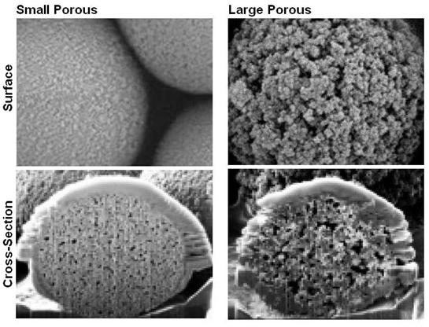
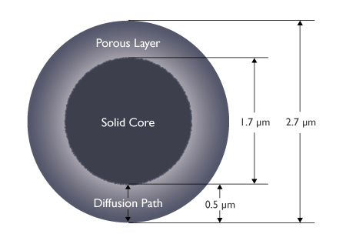
SPP Technology from AMT
HALO 90 Å, 2.7 µm
Brief terminology lesson:
FPP – Fully Porous Particle
TPP- Totally Porous Particle
SPP – Superficially Porous Particle
Terms associated with SPP – Fused-Core®, solid-core, core shell
Fully Porous Particle (FPP)
Superficially Porous Particle (SPP)
Notes:
Before diving into pore-size effects, it’s important to step back and look at column design. Modern oligo separations rely on contemporary materials—primarily superficially porous particles (SPP) and small-particle technologies that deliver high efficiency and strong pH stability. These materials are engineered to minimize diffusion distances, which directly impacts the C term of the van Deemter equation.
I’ll introduce the van Deemter relationship soon and show the curve, emphasizing that the C term is entirely diffusion dependent. For oligonucleotides, where diffusion is inherently slow, the C term dominates performance at higher flow rates. That’s why short diffusion path lengths in SPP materials are so critical.
And because oligonucleotides are amphoteric polyelectrolytes, their interactions with the stationary phase involve a complex combination of hydrophobic interactions, ionic interactions, and secondary surface interactions. All of this reinforces the need for stable materials with fast mass‑transfer characteristics.

Slide 7
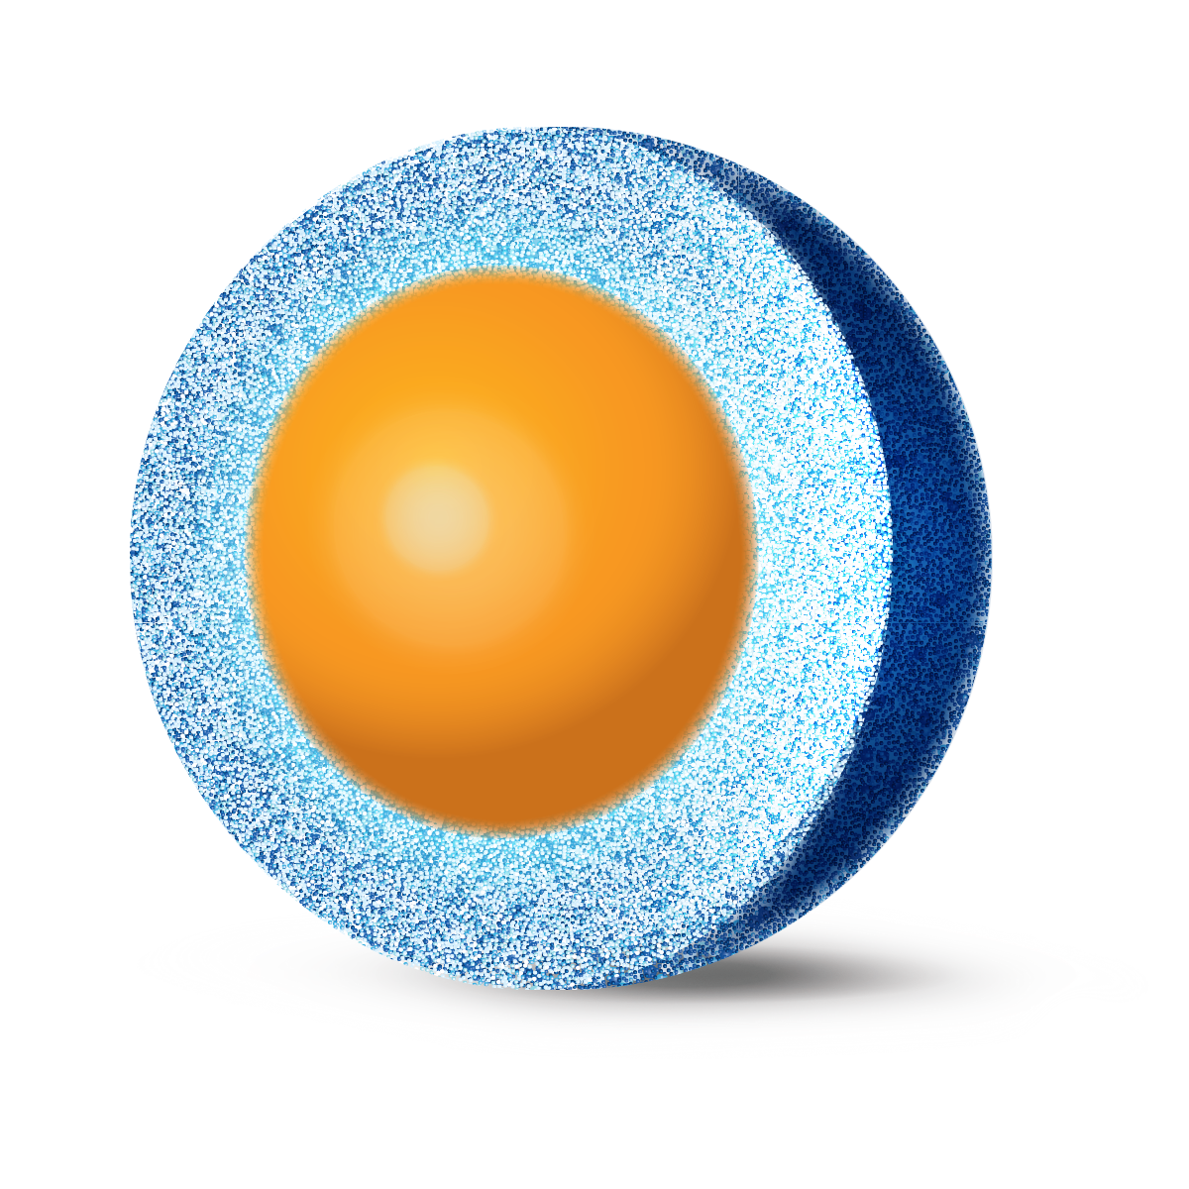
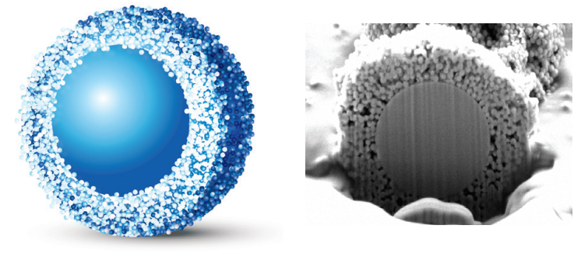
Stationary Phase Pore Size Effects
Impact of Pore Size on Diffusion​
Small pores restrict diffusion of large biomolecules, reducing column efficiency in chromatography.​
Optimal Pore Sizes for Oligonucleotides​
Optimal pore size generally scales with oligonucleotide length, with shorter oligos favoring smaller pores and longer oligos requiring larger pores to minimize steric hindrance and maintain efficient mass transfer.
Trade-offs in Pore Size Selection​
Increasing pore size reduces surface area, affecting loading capacity and retention.​
Mass Transfer Optimization​
Understanding mass transfer dynamics aids in selecting columns for efficient and robust oligonucleotide separation.
120 Å
1000 Å
Notes:
Mass transfer limitations are a critical factor in oligonucleotide chromatography, and stationary phase pore size plays a central role in mitigating these effects. Lessons from protein and peptide separations reveal that restricted diffusion within small pores significantly reduces column efficiency for large biomolecules. Oligonucleotides, with molecular weights ranging from several thousand to tens of thousands of Daltons, require sufficient pore accessibility to avoid steric hindrance. Small pores (≤120 Å) are suitable for small molecules and short oligos, but longer sequences or duplex structures demand larger pores, often in the range of 300–1000 Å. Larger pores facilitate faster intraparticle diffusion, improving peak shape and resolution. However, increasing pore size reduces surface area, which can lower loading capacity and affect retention. Balancing these trade-offs is essential for method development. Understanding mass transfer dynamics helps analysts select columns that optimize efficiency while maintaining adequate retention, ensuring robust performance for diverse oligonucleotide applications.

Slide 8
Pore Size Effects at Work
Retention and band width strongly depend on temperature, ion‑pair concentration, solvent strength, and linear velocity.
Pressure‑dependent retention complicates interpretation of flow‑rate effects on efficiency.
Larger‑pore particles maintain higher efficiency at high flow for the 90‑mer and show band‑width benefits for the 30‑mer at lower flow.
Restricted diffusion in smaller pores increases mass‑transfer resistance, even with SPP morphology.
120 Å
1000 Å
Notes:
Retention and band width in oligonucleotide IP–RP are highly sensitive to several conditions, including temperature, ion‑pair concentration, solvent strength, and linear velocity. Because retention changes with pressure, analyzing flow‑rate effects using the van Deemter framework becomes more difficult, especially under gradient elution.
To address this, we can use an approach similar to what Stoll and colleagues described in 2025. By adjusting solvent strength according to the linear solvent strength model, we can hold retention constant while evaluating column efficiency—this helps separate true efficiency changes from pressure‑related retention shifts.
When we compare the two 2.7 µm particle types, their column permeabilities are essentially the same. However, the larger‑pore particles show a clear advantage: they lose far less efficiency at high flow for the 90‑mer, and they also improve the 30‑mer band width at lower flow rates.
These differences trace back to mass‑transfer limitations. Smaller pores restrict diffusion more strongly, even though the SPP particle design already minimizes diffusion path lengths. Stoll et al. observed similar dependencies for smaller oligonucleotides using small‑pore fully porous particles, reinforcing these trends.

Slide 9

Greater Peak Capacity for Larger Pore SPP: TEA/HFIP Acetonitrile
(0.25% AcN/min)
Conditions:
Columns: 2.1 x 100 mm, Inert HW
Flow Rate: 0.5 mL/min
Temp: 60°C
A- 15 mM TEA/50 mM HFIP, pH 8.9
B- Acetonitrile
Gradient: Time %
0.0 1.5
20 6.5 21 15
22 15
22.5 1.5
30 Stop
Detection: 260 nm, 10 nm
Sample: 1 μL, 20/100 IDT @ 10ng
uV
25000
20
30
40
50
100
22500
20000
17500
PW_{1/2} 4.2s
PW_{1/2} 6.1s
15000
12500
120Å
PC = 55.5
10000
7500
PW_{1/2} 3.9s
5000
PW_{1/2} 2.8s
1000Å
$$PC= ∆(Rt100−Rt20)/4σavg$$
2500
PC = 105.7
0
6.0
7.0
8.0
9.0
10.0
11.0
12.0
13.0
14.0
15.0
16.0
17.0
18.0
min

Slide 10
Resolution of Longer Oligonucleotides
(0.125% AcN/min)
Conditions:
Columns: 2.1 x 100 mm, Inert HW
Flow Rate: 0.5 mL/min
Temp: 60°C
A- 15 mM TEA/50 mM HFIP, pH 8.9
B- Acetonitrile
Gradient: Time %
0.0 1.5
40 6.5 41 15
42 15
43 1.5
50 Stop
Detection: 260 nm, 10 nm
Sample: 1 μL, 20/100 IDT @ 10ng
uV
50
9000
60
70
80
90
100
8000
7000
6000
Rs₍₁₀₀₋₉₀₎ = 2.05
5000
4000
3000
2000
Rs₍₁₀₀₋₉₀₎ = 3.1
1000
0
25.5
26.0
26.5
27.0
27.5
28.0
28.5
29.0
29.5
30.0
30.5
31.0
31.5
32.0
32.5
min
Adjusting gradient for closer matching of Rt across this sample yields little effect on Rs or PC

Slide 11
IP/RP Oligo Column Challenges
Fully Porous Silica Particles
Pros
High-pH Resistance
Moderate Pore Sizes Available
Cons
Large Pores Structurally Unsound
Pressure Limits
High Backpressures limiting column length

Slide 12
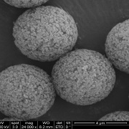
IP/RP Oligo Column Challenges
Polymer-Based
Pros
Extreme pH durability
Available in “1000Å”
Cons
Large Particle Sizes
Non-Uniform Pore Sizes
Significant Pressure Limitations
Poly-divinylBenzene

Slide 13
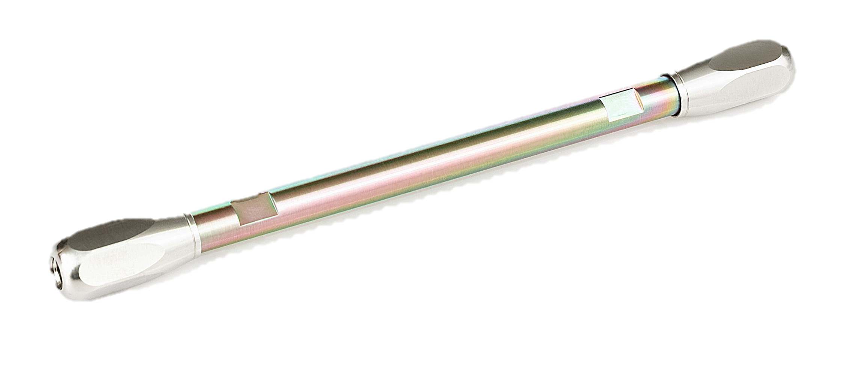
HALO 1000Å OLIGO C18
15,000 PSI Operating Pressure
High pH Resistance
1000Å Pores for Efficient Mass Transfer
Fused-Core® Silica Technology
Particle Monodispersity and Pore Size Uniformity
2.7µm

Slide 14
Separation of a 90-mer ssDNA
HALO 1000 Å OLIGO C18, 2.7µm, 2.1 x 150 mm
Mobile Phase A: 10mM Diisobutylamine(DiBA)
100mM Hexafluoroisopropanol (HFIP)
5% Methanol/5% Acetonitrile
Mobile Phase B: 10mM DiBA
100mM HFIP
5% Methanol/50% Acetonitrile
Gradient: Time %B
0.00 0
120 32
125 50
125.1 0
130 0
Flow Rate: 0.2 ml/min
Temperature: 60 °C

Slide 15
Sample Peak Capacity Comparison
Crude 90-mer ssDNA
60 min gradient
22 impurities
EIC via MS1 LC/MS
340 Bar
Peak Capacity = 1+ (T_{g} / W_{1/2})
T_{g} = Gradient Time
W_{1/2} = Avg Peak Width @ HH
Sample Peak Capacity
N_{c} = P_{c} x (T_{z}-T_{a})/T_{g}
T_{z} = RT last eluting peak
T_{a} = RT first eluting peak
147 Bar
128 Bar
100 Bar

Slide 16
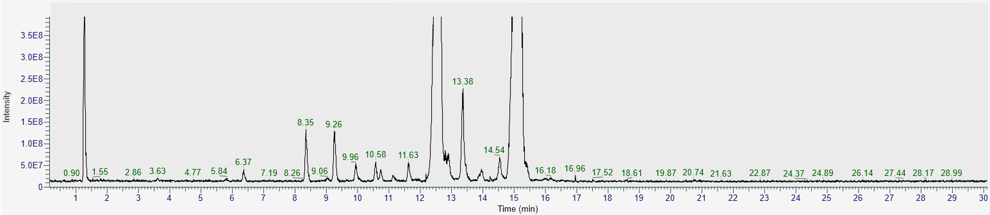
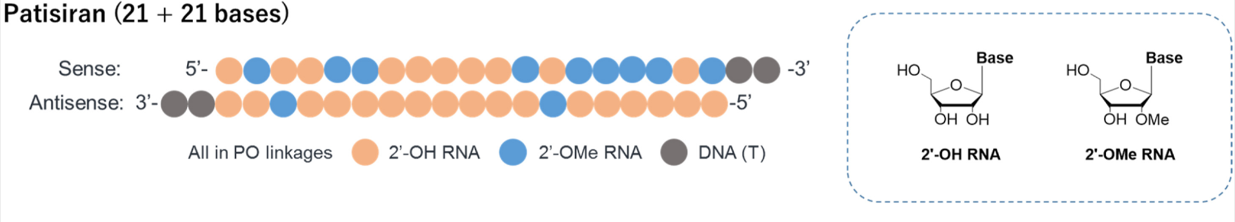
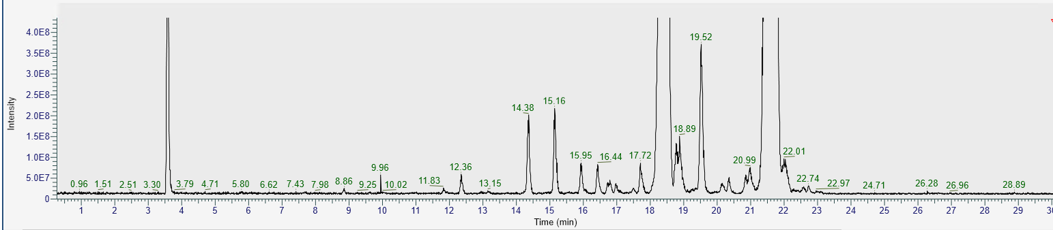
Patisiran siRNA
2.1x150mm, Same Gradient
RRT: 1.20
Relative Retention Time is Similar
Retention Time Significantly Reduced!
Void (K₀)
RRT: 1.18
AS
Sense
AS:AUmACUCUUGGUUmACTT
AS:GAAUmACUCUUGGUUmACTT
S:ACmCmAAGAGUmAUmUmCmCmAUmTT
S:UmAUmUmCmCmAUmTT
A: 10mM DiPA, 100mM HFIP, 5% MeOH, 5% ACN
B: 10mM DiPA, 100mM HFIP, 5% MeOH, 25% ACN
Gradient: 0-30 min; 0-80%B
Temp: 60°C; 0.25ml/min
3x 2.1x150mm HALO 1000Å OLIGO C18, 2.7µm
Pressure: 610Bar
Suzuki, Y. et al Drug Metabolism and Pharmacokinetics 2021 (41)
Notes:
Make difference more prominent

Slide 17
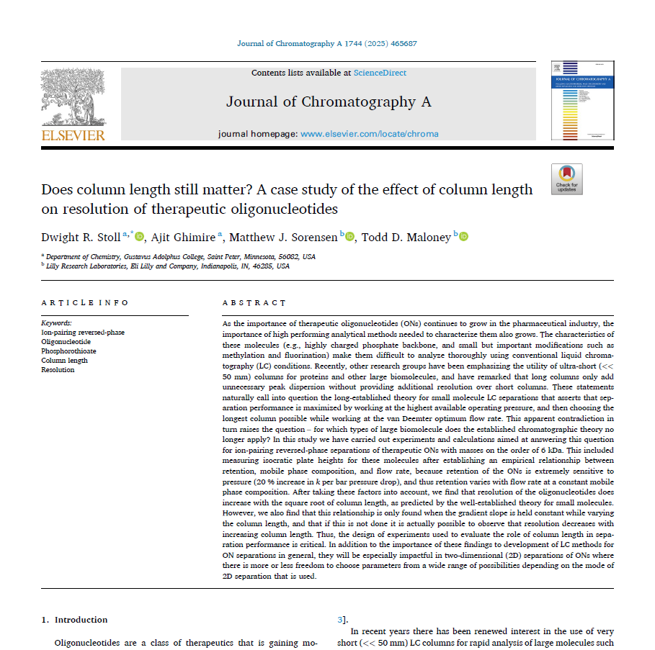
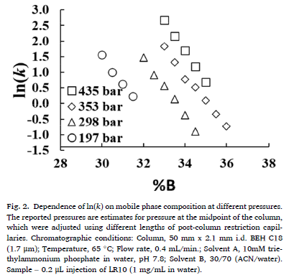
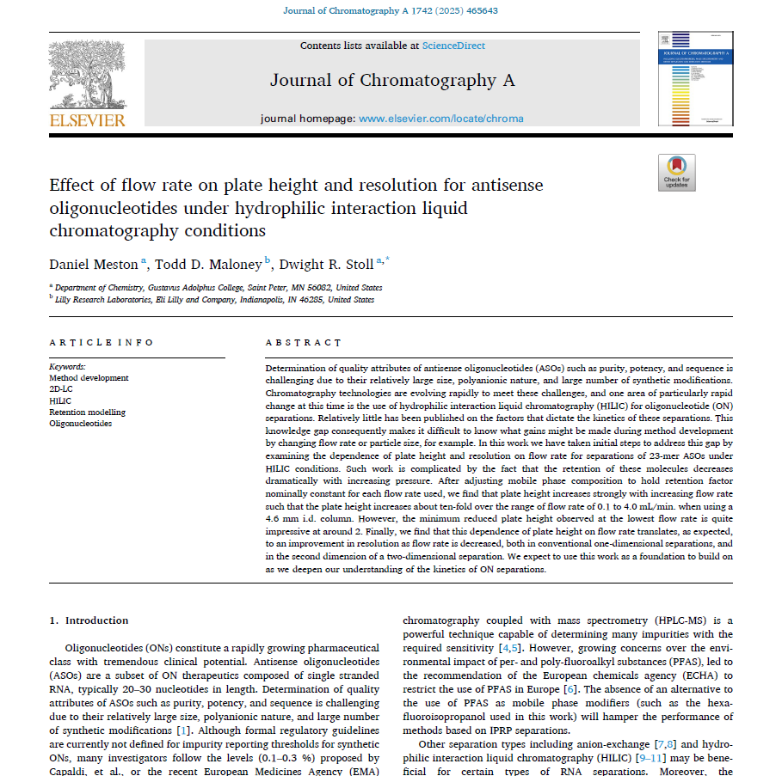
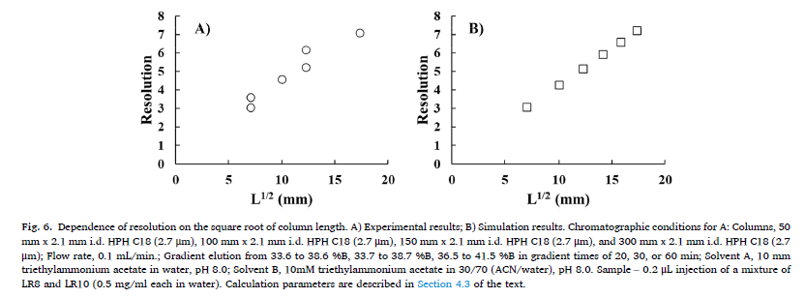
Retention is Pressure Dependent
Pressure and composition as independent variables
Column length matters, especially at lower gradient steepness.
Notes:
There is additional evidence that wide pore silica outperforms wide pore polymer, likely due to better control of pore size distrbution

Slide 18
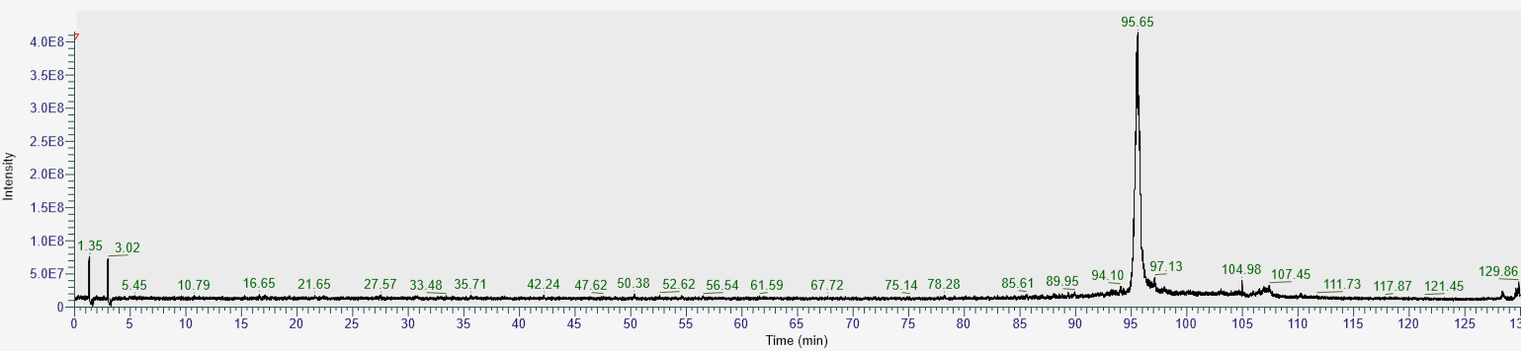
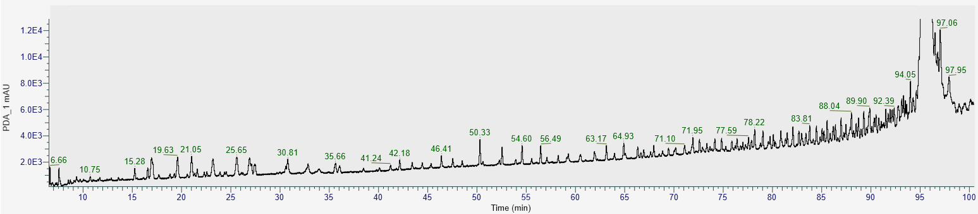
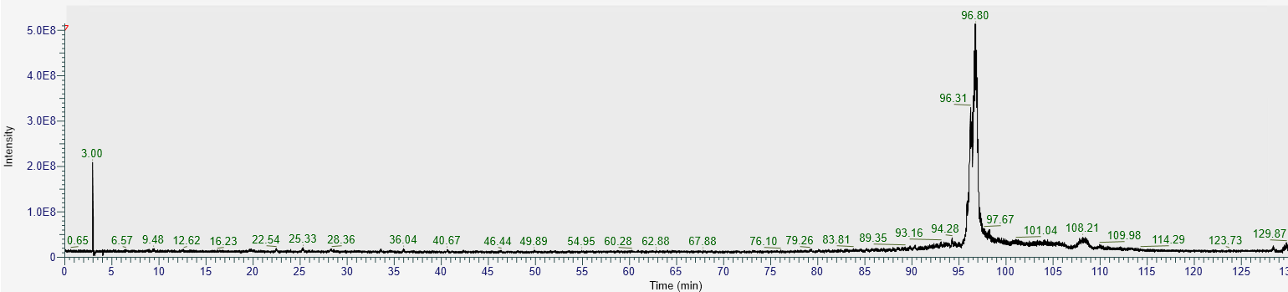
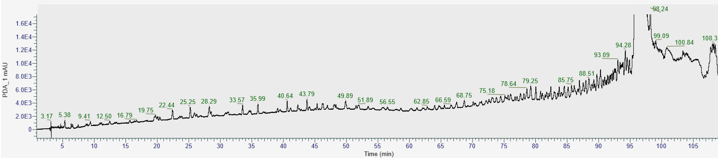
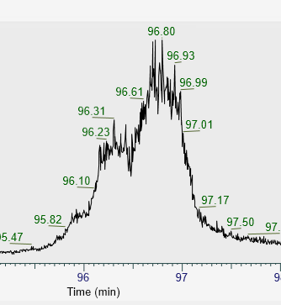
sgRNA Thiolation
mU*mA*mG* CAUAGACCUGCCACUCUGUUUUAGAGCUAGAAAUAGCAAGUUAAAAUAAGGCUAGUCCGUUAUCAACUUGAAAAAGUGGCACCGAGUCGGUGCmU*mU*mU* rU
mU mA mG CAUAGACCUGCCACUCUGUUUUAGAGCUAGAAAUAGCAAGUUAAAAUAAGGCUAGUCCGUUAUCAACUUGAAAAAGUGGCACCGAGUCGGUGC mU mU mU rU
m= 2-Ome; * = Phosphorothioated
A: 10mM DiPA,
100mM HFIP,
5% MeOH,
5% ACN
B: 10mM DiPA,
100mM HFIP,
5% MeOH,
25% ACN
Gradient: 0-30 min 0-80%B
Temp: 60°C
0.25ml/min
TIC; non-thiolated
UV 260nm
3x 2.1x150mm HALO OLIGO C18 1000Å, 2.7µm
Pressure: 610Bar
TIC- 6x
phosphorothioated
UV 260nm
Notes:
Animate peak shape

Slide 19
Less Backpressure = longer columns
920 Bar
605 Bar
485 Bar
305 Bar
128 Bar
3x [2.1 x 250mm] (750mm) columns remains under the Backpressure Limit!
10mM DiBA, 100mM HFIP, 5%MeOH, 15% ACN

Slide 20
Summary
Oligonucleotide therapeutics are growing in size and becoming increasingly complex
There is need for developing improved chromatographic methods and materials
First high pressure rated 1000Å pore silica particle
Low backpressure
Improved Mass Transfer Profile (Van Deemter C-term)
Lower Backpressures means longer columns
Longer column lengths do provide improved resolving power!

Slide 21
Peter Pellegrinelli, Barry Boyes, Joshua McBee

